Slide 2
SQL DW Gen2: New Features & Enhancements
Kal Yella

Slide 3
Agenda
Adaptive cache internals
Resource classes on Gen2
Instant data movement on Gen2
Security Enhancements
Workload Management
What’s New since Gen2

Slide 4
Adaptive cache

Slide 5
Gen2 Architecture bottomless storage
Control
Cores
Memory
SSD TempDB
Cores
Memory
Cores
Memory
Cores
Memory
NVMe SSD
NVMe SSD
NVMe SSD
Compute
Cache
TempDB
Cache
TempDB
Cache
TempDB
Data
Remote storage
Snapshot backups
Log
Notes:
Non-Volatile Memory / Flash Memory hosting Cache and tempdb
NVM Express reduces I/O overhead and brings various performance improvements in comparison to previous logical-device interfaces, including multiple, long command queues, and reduced latency.

Slide 6
Automated Tiering Of Storage Layers
Node
Capacity
Access
Time
Memory
Adaptive Cache
Remote Storage
hot data
300GB+
70 ns
1.5TB
warm data
20 µs
∞
100 ms
cold data

Slide 7
Adaptive cache miss (cold scan)
SELECT SUM(TotalCost)
FROM FactSales_CCI
Adaptive cache hit (hot scan)
SELECT SUM(TotalCost)
FROM FactSales_CCI
Columnstore Object Pool
Memory
Hit?
Adaptive
Cache
Local NVMe SSD
Hit?
Remote storage
Remote Read
Notes:
Non-Volatile Memory / Flash Memory hosting Cache and tempdb
NVM Express reduces I/O overhead and brings various performance improvements in comparison to previous logical-device interfaces, including multiple, long command queues, and reduced latency.

Slide 8
Clearing the adaptive cache
DBCC DROPCLEANBUFFERS (ALL)
Pause or Scale
Columnstore Object Pool
Memory
Update costing info
Adaptive
Cache
Local NVMe SSD
Remote storage
Notes:
Non-Volatile Memory / Flash Memory hosting Cache and tempdb
NVM Express reduces I/O overhead and brings various performance improvements in comparison to previous logical-device interfaces, including multiple, long command queues, and reduced latency.

Slide 9
Adaptive cache miss (full cache, cold scan)
SELECT SUM(TotalCost)
FROM FactSales_CCI
SELECT SUM(TotalCost)
FROM FactSales_CCI
Columnstore Object Pool
Memory
Hit?
Full Adaptive
Cache
Local NVMe SSD
Hit?
Remote storage
Remote Read
Notes:
Non-Volatile Memory / Flash Memory hosting Cache and tempdb
NVM Express reduces I/O overhead and brings various performance improvements in comparison to previous logical-device interfaces, including multiple, long command queues, and reduced latency.
Go into the algorithm – oldest accessed segment

Slide 10
Monitoring and tuning the Gen2 cache
 | High Cache hit ratio | Low Cache hit ratio
High Cache fill ratio | Optimal usage | Scale up
Low Cache fill ratio | Scale down | Cache hydration
Notes:
Would decreasing resource class increase gen2 cache hit ratio? Less memory…is it columnstore object pool memory that gets decreased with rc?

Slide 11
Sizing the Gen2 Cache
Working set ~20%
1.5TB Gen2 cache per DWU 500
EXEC sp_spaceused
Same TempDB on both Gen1 and Gen2
This cache is per node
DWU | Memory (GB) | Tempdb (TB) | Gen2 Cache (TB)
1000 | 720 | 4 | 3
1500 | 1080 | 5 | 4.5
2000 | 1440 | 7 | 6
2500 | 1800 | 9 | 7.5
3000 | 2160 | 11 | 9
5000 | 3600 | 18 | 15
6000 | 4320 | 22 | 18
7500 | 5400 | 27 | 22.5
10000 | 7200 | 36 | 30
15000 | 10800 | 54 | 45
30000 | 21600 | 108 | 90

Slide 12
CREATE TABLE #gen2Table_HEAP
WITH
(
HEAP,
DISTRIBUTION = ROUND_ROBIN
)
AS SELECT * FROM externalGen2Table;
SELECT SUM(TotalCost)
FROM gen2TableCCI
SELECT SUM(TotalCost)
FROM gen2TableHeap
CREATE TABLE gen2TableCCI
WITH
(
CLUSTERED COLUMNSTORE INDEX,
DISTRIBUTION = ROUND_ROBIN
)
AS SELECT * FROM externalGen2Table;
Loading into Gen2
CREATE TABLE gen2TableHeap
WITH
(
HEAP,
DISTRIBUTION = ROUND_ROBIN
)
AS SELECT * FROM externalGen2Table;
SELECT SUM(TotalCost)
FROM #gen2TableHeap
Columnstore Object Pool
Buffer
Pool
Memory
Gen2
Cache
Tempdb
Local NVMe SSD
Remote storage
External storage
ExternalFiles
Notes:
Non-Volatile Memory / Flash Memory hosting Cache and tempdb
NVM Express reduces I/O overhead and brings various performance improvements in comparison to previous logical-device interfaces, including multiple, long command queues, and reduced latency.
tempdb (running out of tempdb so up in size) visuals

Slide 13
Gen2 Loading Guidance
Use ELT where possible
Leverage HEAP for initial load
Faster load time
Prevent cache population/eviction
Assign appropriate resource class for optimal CCI compression

Slide 14
Gen2 Resource Classes

Slide 15
History of Dynamic Resource Classes
On Gen1, SmallRc is really a static resource class
As the instance is scaled, more queries can run
The performance remains constant
Desired default behavior, as instance scales, queries run faster
Notes:
Not ideal for default behavior.

Slide 16
Gen1 - Inconsistent Concurrency
As services levels change, concurrency fluctuates
Scaling from DW1500 to DW2000 reduces concurrency from 4 to 3
Gen1 Concurrency Slot Options
1
2
4
8
16
32
64
128
Notes:
Gen1 has fixed resource pools that memory grants and concurrency use

Slide 17
Gen2 – Simpler resource model
With Gen2, dynamic resource pools were introduced with a 3-10-22-70 model for resource allocations.
Instead of choosing from 8 resource pools, they are calculated on the fly per service level.
Resource Class | Percent Resources
SmallRc | 3%
MediumRc | 10%
LargeRc | 22%
XLargeRc | 70%
Resource Class | Percent Resources | Concurrency
SmallRc | 3% | 32
MediumRc | 10% | 10
LargeRc | 22% | 4
XLargeRc | 70% | 1

Slide 18
Gen2 – Simpler model
At MediumRc, an example…
MediumRC |  | Gen1 Model |  | Gen2 Model
Service Level | Total Slots | Slots | Concurrency | Slots | Concurrency
DW1000c | 40 | 8 | 5 | 4 | 10
DW1500c | 60 | 8 | 7 | 6 | 10
DW2000c | 80 | 16 | 5 | 8 | 10
DW2500c | 100 | 16 | 6 | 10 | 10
DW3000c | 120 | 16 | 7 | 12 | 10
DW5000c | 200 | 32 | 6 | 20 | 10
DW6000c | 240 | 32 | 7 | 24 | 10
DW7500c | 300 | 64 | 4 | 30 | 10
DW10000c | 400 | 64 | 6 | 40 | 10
DW15000c | 600 | 64 | 9 | 60 | 10
DW30000c | 1200 | 64 | 18 | 120 | 10

Slide 19
Gen2 Performance Accelerator

Slide 20
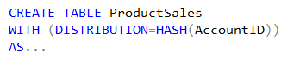
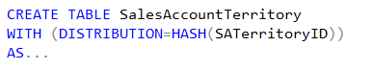
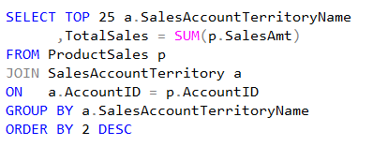
Distributed Data Movement
ProductSales
SalesAccountTerritory
AccountID | SalesAmt | …
47 | $1,234.36 | …
36 | $2,345.47 | …
14 | $3,456.58 | …
25 | $4,567.69 | …
48 | $5,678.70 | …
37 | $6,789.81 | …
… | … | …
SATerritoryID | AccountID | …
444 | 37 | …
333 | 25
111 | 36 | …
222 | 47 | …
445 | 14
334 | 48 | …
… | … | …
Node 1:
Node 2:
Node 3:
Node 4:
Node 5:
Node 6:
Shuffle
SATName | TotalSales
North | $6,789.81
South | $5,678.70
NorthEast | $4,567.69
SouthWest | $3,456.58
East | $2,345.47
West | $1,234.36
AccountID | SATName | …
47 | West | …
36 | East
14 | SouthWest | …
25 | NorthEast | …
48 | South
37 | North | …
… | … | …

Slide 21
Gen1 – Data Movement Service
SQL DW Compute Node 2
SQL Engine
Distributed Tables
TEMP DB
SQL DW Compute Node 1
SQL Engine
Data Movement Service
Distributed Tables
TEMP DB
SQL DW Compute Node 3
Data Movement Service
SQL Engine
Distributed Tables
TEMP DB
Stand-alone process, fixed memory
Single-threaded read – BulkCopy API
Copy is not scalable (cores and network)
Data Movement Service

Slide 22
Gen2 – instant data movement
SQL DW Compute Node 2
SQL Engine
Distributed Tables
SQL DW Compute Node 1
TEMP DB
SQL Engine
Distributed Tables
TEMP DB
SQL DW Compute Node 3
SQL Engine
Distributed Tables
Data does not leave SQL Engine
Batch-mode: minimal overhead
Scalable: leverages all cores and network
TEMP DB

Slide 23
Lower Entry Point
Gen1
Gen2
Gen2-L.E.
Cores
Memory
Cores
Memory
NVMe SSD
NVMe SSD
Cache
Tempdb
Cache
Tempdb
DW1000c – DW30000c
Cores
Memory
NVMe SSD
Cache
Tempdb
DW100c – DW500c
Cores
Memory
SSD Tempdb
DW100 - DW6000
Notes:
6 cores, 42 GB ram per node
36 cores, 360 GB ram

Slide 24
Industry Leading Performance

Slide 25
Industry Leading Performance

Slide 26
Gen2 Performance Announcement Details
Gen2 GA
Turbocharge cloud analytics with Azure SQL Data Warehouse
Blazing fast data warehousing with Azure SQL Data Warehouse
Adaptive Caching
Adaptive caching powers Azure SQL Data Warehouse performance gains
Instant data movement
Lightning fast query performance with Azure SQL Data Warehouse
GigaOm Benchmarking Report
https://gigaom.com/report/data-warehouse-in-the-cloud-benchmark/

Slide 27
Gen2 Future Goodies
Region parity – capacity expansion
Instant data movement vNext
Cache Optimizations
Intelligence on what to cache
Faster eviction
Cache on load
Pre-cache on scale – pause/resume

Slide 28
Security Enhancements

Slide 29
Row-level security (RLS)
Overview
Fine grained access control of specific rows in a database table
Help prevent unauthorized access when multiple users share the same tables
Eliminates need to implement connection filtering in multitenant applications
Administer via SQL Server Management Studio or SQL Server Data Tools
Easily locate enforcement logic inside the database and schema bound to the table
Customer 1
Customer 2
Customer 3
SQL Data Warehouse
Notes:
Objective: Row-Level Security (RLS) simplifies the design and coding of security in your application.
Talking Points:
RLS enables you to implement restrictions on data row access. For example, ensuring that workers can access only those data rows that are pertinent to their department, or restricting a customer's data access to only the data relevant to their company.
The access restriction logic is located in the database tier rather than away from the data in another application tier. The database system applies the access restrictions every time that data access is attempted from any tier. This makes your security system more reliable and robust by reducing the surface area of your security system.
Implement RLS by using the CREATE SECURITY POLICY Transact-SQL statement, and predicates created as inline table valued functions.
Source: https://docs.microsoft.com/en-us/sql/relational-databases/security/row-level-security?toc=%2Fazure%2Fsql-data-warehouse%2Ftoc.json&view=sql-server-2017

Slide 30
RLS - Create a security policy
Create a security policy for row-level security
The following examples demonstrate the use of the CREATE SECURITY POLICY syntax
-- The following syntax creates a security policy with a filter predicate for the Customer table
CREATE SECURITY POLICY [FederatedSecurityPolicy]
ADD FILTER PREDICATE [rls].[fn_securitypredicate]([CustomerId])
ON [dbo].[Customer];
-- Create a new schema and predicate function, which will use the application user ID stored in CONTEXT_INFO to filter rows.
CREATE FUNCTION rls.fn_securitypredicate (@AppUserId int)
RETURNS TABLE
WITH SCHEMABINDING
AS
RETURN (
SELECT 1 AS fn_securitypredicate_result
WHERE
DATABASE_PRINCIPAL_ID() = DATABASE_PRINCIPAL_ID('dbo') -- application context
AND CONTEXT_INFO() = CONVERT(VARBINARY(128), @AppUserId));
GO
Notes:
Objective: Row-level filtering of data selected from a table is enacted through a security predicate filter defined as an inline table valued function. The function is then invoked and enforced by a security policy. The policy can restrict the rows that may be viewed (a filter predicate), but does not restrict the rows that can be inserted or updated from a table (a blocking predicate). There is no indication to the application that rows have been filtered from the result set; if all rows are filtered, then a null set will be returned.
Talking Points:
Filter predicates are applied while reading data from the base table, and it affects all get operations: SELECT, DELETE (i.e. user cannot delete rows that are filtered), and UPDATE (i.e. user cannot update rows that are filtered, although it is possible to update rows in such way that they will be subsequently filtered). Blocking predicates are not available in this version of RLS, but equivalent functionality (i.e. user cannot INSERT or UPDATE rows such that they will subsequently be filtered) can be implemented using check constraints or triggers.
Filter predicates and security policies have the following behavior:
Define a security policy that filters the rows of a table. The application is unaware that any rows have been filtered for SELECT, UPDATE, and DELETE operations, including situations where all the rows have been filtered out. The application can INSERT any rows, regardless of whether or not they will be filtered during any other operation. Define a predicate function that joins with another table and/or invokes a function. The join/function is accessible from the query and works as expected without any additional permission checks.
Issue a query against a table that has a security predicate defined but disabled. Any rows that would have been filtered or restricted are not affected.
The dbo user, a member of the db_owner role, or the table owner queries against a table that has a security policy defined and enabled. Rows are filtered/restricted as defined by the security policy.
Attempts to alter the schema of a table bound by a security policy will result in an error. However, columns not referenced by the filter predicate can be altered.
Attempts to add a predicate on a table that already has one defined (regardless of whether it is enabled or disabled) results in an error.
Attempts to modify a function used as a predicate on a table within a security policy results in an error.
Defining multiple active security policies that contain non-overlapping predicates, succeeds.
Source: https://msdn.microsoft.com/en-us/library/azure/dn765131.aspx

Slide 31
RLS in three steps
1. Policy manager creates filter predicate and security policy in T-SQL, binding the predicate to the Patients table
2. App user (e.g., nurse) selects from Patients table
3. Security policy transparently rewrites query to apply filter predicate
Policy manager
Database
CREATE FUNCTION dbo.fn_securitypredicate(@wing int)
RETURNS TABLE WITH SCHEMABINDING AS
return SELECT 1 as [fn_securitypredicate_result] FROM
StaffDuties d INNER JOIN Employees e
ON (d.EmpId = e.EmpId)
WHERE e.UserSID = SUSER_SID() AND @wing = d.Wing;
CREATE SECURITY POLICY dbo.SecPol
ADD FILTER PREDICATE dbo.fn_securitypredicate(Wing) ON Patients
WITH (STATE = ON)
Security policy
Filter Predicate:
INNER JOIN…
Nurse
Patients
Application
SELECT * FROM Patients
SEMIJOIN APPLY dbo.fn_securitypredicate(patients.Wing);
SELECT * FROM Patients
SELECT Patients.* FROM Patients,
StaffDuties d INNER JOIN Employees e ON (d.EmpId = e.EmpId)
WHERE e.UserSID = SUSER_SID() AND Patients.wing = d.Wing;
Notes:
Talking Points:
Policy manager creates a filter predicate and security policy
App user (e.g., a nurse) selects from the patient’s table
The query is transparently rewritten to apply the filter predicate
Notice: No app changes!

Slide 32

COLUMN-level security (CLS)
Overview
Control access of specific columns in a database table based on customer’s group membership or execution context
Simplifies the design and implementation of security by putting restriction logic in database tier as opposed to application tier
Administer via GRANT T-SQL statement
Both Azure Active Directory (AAD) and SQL authentication are supported
Notes:
Objective: Column-Level Security (CLS) simplifies the design and coding of security in your application.
Use Cases
Some examples of how CLS is being used today:
A financial services firm allows only account managers to have access to customer social security numbers (SSN), phone numbers, and other personally identifiable information (PII).
A health care provider allows only doctors and nurses to have access to sensitive medical records while not allowing members of the billing department to view this data.
Source: https://docs.microsoft.com/en-us/azure/sql-data-warehouse/column-level-security

Slide 33
CLS in three steps
1. Policy manager creates permission policy in T-SQL, binding the policy to the Patients table on a specific group
2. App user (e.g., nurse) selects from Patients table
3. Permission policy prevents access on sensitive data
Database
Policy manager
CREATE TABLE Patients (
PatientID int IDENTITY,
FirstName varchar(100) NULL,
SSN char(9) NOT NULL,
LastName varchar(100) NOT NULL,
Phone varchar(12) NULL,
Email varchar(100) NULL
);
Patients
Nurse
Application
Permission policy
GRANT SELECT ON Patients (
PatientID, FirstName, LastName, Phone, Email
) TO Nurse;
SELECT * FROM Membership;
Msg 230, Level 14, State 1, Line 12
The SELECT permission was denied on the column 'SSN' of the object 'Membership', database 'CLS_TestDW', schema 'dbo'.
Allow ‘Nurse’ to access all columns except for sensitive SSN column
Queries executed as ‘Nurse’ will fail if they include the SSN column
Notes:
Talking Points:
Policy manager creates permission policy on Nurse against Patients table
App user (e.g., a nurse) selects from the patient’s table
The query is rejected if it violates permission policy
* Notice: No app changes!

Slide 34
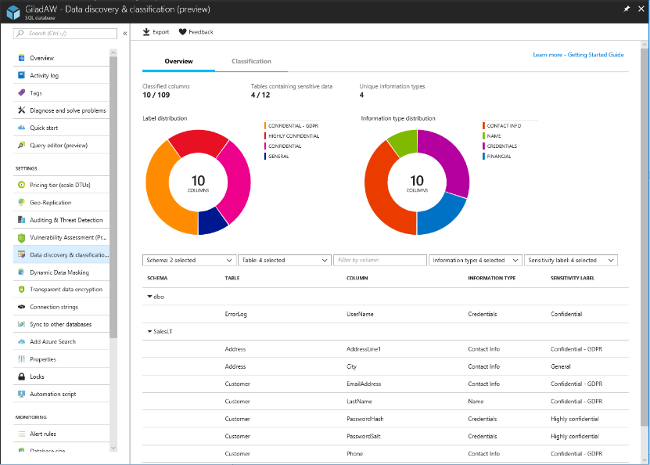
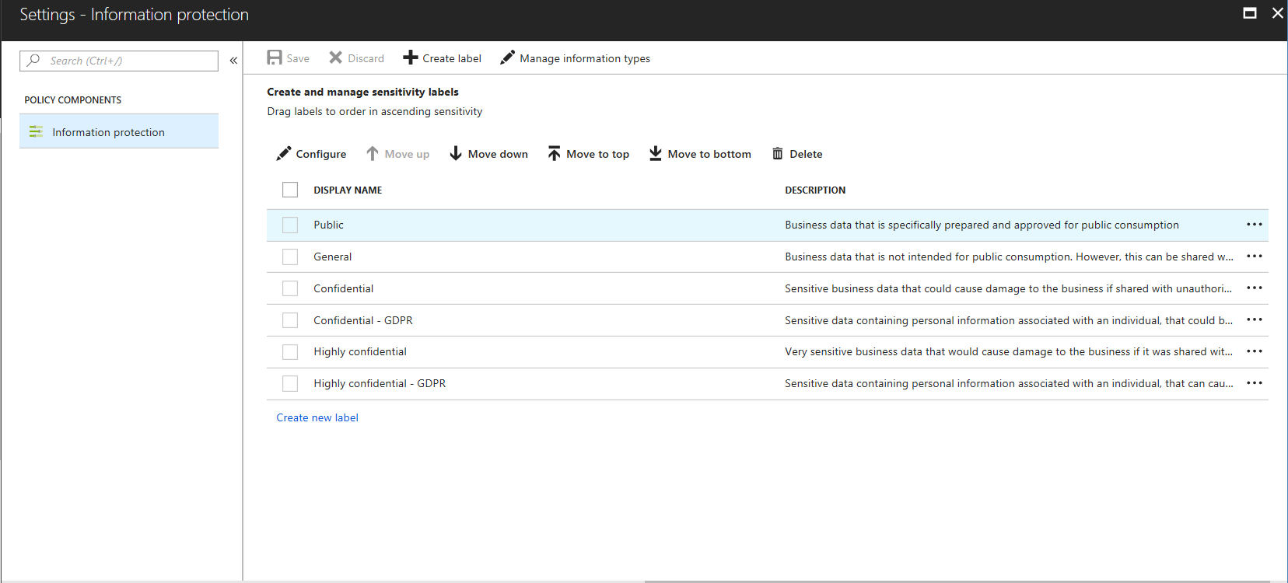
SQL Data discovery & classification PRE
Overview
Automatic discovery of columns with sensitive data
Add persistent sensitive data labels
Audit and detect access to the sensitive data
Manage labels for your entire Azure tenant using Azure Security Center
Discover
Classify
Label

Slide 35
Workload Management

Slide 36
WORKLOAD CLASSIFICATION
Overview
CREATE WORKLOAD CLASSIFIER classifier_name
WITH
(
[WORKLOAD_GROUP = '<Resource Class>' ]
[IMPORTANCE = { LOW |
BELOW_NORMAL |
NORMAL |
ABOVE_NORMAL |
HIGH
}
]
[MEMBERNAME = ‘security_account’]
)
Allows you to map a query to an allocation of resources via pre-determined rules
Use this in combination with workload importance to effectively share resources across different workload types
Notes:
Talking Points:
Use the ALTER DATABASE statement to enable the query store.
ALTER DATABASE Databasename SET QUERY_STORE = ON;
Query Store catalog views:
sys.database_query_store_options (Transact-SQL)
sys.query_context_settings (Transact-SQL)
sys.query_store_plan (Transact-SQL)
sys.query_store_query (Transact-SQL)
sys.query_store_query_text (Transact-SQL)
sys.query_store_runtime_stats (Transact-SQL)
sys.query_store_runtime_stats_interval (Transact-SQL)
Query Store stored procedures:
sp_query_store_flush_db (Transact-SQL)
sp_query_store_force_plan (Transact-SQL)
sp_query_store_remove_plan (Transct-SQL)
sp_query_store_remove_query (Transact-SQL)
sp_query_store_reset_exec_stats (Transact-SQL)
sp_query_store_unforce_plan (Transact-SQL)

Slide 37




WORKLOAD IMPORTANCE – no importance
Scheduler without importance
Overview
CEO
CEO
CEO
Workload importance allows you to prioritize the queries that get access to resources. It helps ensure that high-business value work is executed first on a busy data warehouse.
1
2
3
9
4
5
10
6
7
8
10
9
11
12
10
11
12
Running
Queued
Queued
Queued
Notes:
Talking Points:
Use the ALTER DATABASE statement to enable the query store.
ALTER DATABASE Databasename SET QUERY_STORE = ON;
Query Store catalog views:
sys.database_query_store_options (Transact-SQL)
sys.query_context_settings (Transact-SQL)
sys.query_store_plan (Transact-SQL)
sys.query_store_query (Transact-SQL)
sys.query_store_query_text (Transact-SQL)
sys.query_store_runtime_stats (Transact-SQL)
sys.query_store_runtime_stats_interval (Transact-SQL)
Query Store stored procedures:
sp_query_store_flush_db (Transact-SQL)
sp_query_store_force_plan (Transact-SQL)
sp_query_store_remove_plan (Transct-SQL)
sp_query_store_remove_query (Transact-SQL)
sp_query_store_reset_exec_stats (Transact-SQL)
sp_query_store_unforce_plan (Transact-SQL)

Slide 38

WORKLOAD IMPORTANCE –importance
Scheduler with Importance
Overview
CEO
CEO
Workload importance allows you to prioritize the queries that get access to resources. It helps ensure that high-business value work is executed first on a busy data warehouse.
1
2
3
12
4
5
6
7
8
9
10
11
12
Normal
Low
Normal
High
Running
Queued
Queued
Notes:
Talking Points:
Use the ALTER DATABASE statement to enable the query store.
ALTER DATABASE Databasename SET QUERY_STORE = ON;
Query Store catalog views:
sys.database_query_store_options (Transact-SQL)
sys.query_context_settings (Transact-SQL)
sys.query_store_plan (Transact-SQL)
sys.query_store_query (Transact-SQL)
sys.query_store_query_text (Transact-SQL)
sys.query_store_runtime_stats (Transact-SQL)
sys.query_store_runtime_stats_interval (Transact-SQL)
Query Store stored procedures:
sp_query_store_flush_db (Transact-SQL)
sp_query_store_force_plan (Transact-SQL)
sp_query_store_remove_plan (Transct-SQL)
sp_query_store_remove_query (Transact-SQL)
sp_query_store_reset_exec_stats (Transact-SQL)
sp_query_store_unforce_plan (Transact-SQL)

Slide 39
SQL DW without Importance
Scheduler without importance
CEO
CEO
CEO
1
2
3
9
4
5
10
6
7
8
10
9
11
12
10
11
12
Running
Queued
Queued
Queued

Slide 40
Importance on a busy system
Scheduler with Importance
CEO
CEO
1
2
3
12
4
5
6
7
8
9
10
11
12
Normal
Low
Normal
High
Running
Queued
Queued

Slide 41
WORKLOAD isolation (Preview)
Overview
CREATE WORKLOAD GROUP group_name
WITH
(
[ MIN_PERCENTAGE_RESOURCE = value ]
[ CAP_PERCENTAGE_RESOURCE = value ]
[ MAX_CONCURRENCY = value ]
)
Isolation allocates fixed resources to workloads within a data warehouse. These limits are strictly enforced for memory, and only enforced under load for CPU and IO.
Notes:
Talking Points:
Use the ALTER DATABASE statement to enable the query store.
ALTER DATABASE Databasename SET QUERY_STORE = ON;
Query Store catalog views:
sys.database_query_store_options (Transact-SQL)
sys.query_context_settings (Transact-SQL)
sys.query_store_plan (Transact-SQL)
sys.query_store_query (Transact-SQL)
sys.query_store_query_text (Transact-SQL)
sys.query_store_runtime_stats (Transact-SQL)
sys.query_store_runtime_stats_interval (Transact-SQL)
Query Store stored procedures:
sp_query_store_flush_db (Transact-SQL)
sp_query_store_force_plan (Transact-SQL)
sp_query_store_remove_plan (Transct-SQL)
sp_query_store_remove_query (Transact-SQL)
sp_query_store_reset_exec_stats (Transact-SQL)
sp_query_store_unforce_plan (Transact-SQL)

Slide 42
WORKLOAD management lifecycle
Overview
Workload management (isolation, classification, and importance) can be used dynamically in response to pressure on the data warehouse. Configure defaults first, then monitor the pressure on the data warehouse system, and adjust configurations as necessary.
Monitor
Analyze
Configure
Notes:
Talking Points:
Use the ALTER DATABASE statement to enable the query store.
ALTER DATABASE Databasename SET QUERY_STORE = ON;
Query Store catalog views:
sys.database_query_store_options (Transact-SQL)
sys.query_context_settings (Transact-SQL)
sys.query_store_plan (Transact-SQL)
sys.query_store_query (Transact-SQL)
sys.query_store_query_text (Transact-SQL)
sys.query_store_runtime_stats (Transact-SQL)
sys.query_store_runtime_stats_interval (Transact-SQL)
Query Store stored procedures:
sp_query_store_flush_db (Transact-SQL)
sp_query_store_force_plan (Transact-SQL)
sp_query_store_remove_plan (Transct-SQL)
sp_query_store_remove_query (Transact-SQL)
sp_query_store_reset_exec_stats (Transact-SQL)
sp_query_store_unforce_plan (Transact-SQL)

Slide 43
Approximate execution
HyperLogLog Accuracy
Will return a result with a 2% accuracy of true cardinality <CONFIDENCE>
e.g. COUNT (DISTINCT) returns 1,000,000, HyperLogLog will return a value in the range of 999,736 to 1,016,234.
APPROX_COUNT_DISTINCT
Returns the approximate number of unique non-null values in a group
-- Syntax
APPROX_COUNT_DISTINCT ( expression )
-- The approximate number of different order keys by order status from the orders table.
SELECT O_OrderStatus, APPROX_COUNT_DISTINCT(O_OrderKey) AS Approx_Distinct_OrderKey
FROM dbo.Orders
GROUP BY O_OrderStatus
ORDER BY O_OrderStatus;

Slide 44
GROUP BY OPTIONS PRE
GROUP BY with ROLLUP
Creates a group for each combination of column expressions
Rolls up the results into subtotals and grand totals.
GROUPING SETS
Combine multiple GROUP BY clauses into one GROUP BY CLAUSE
Equivalent of UNION ALL of specified groups
-- GROUP BY ROLLUP Example --
SELECT Country,
Region,
SUM(Sales) AS TotalSales
FROM Sales
GROUP BY ROLLUP (Country, Region);
-- GROUP BY SETS Example --
SELECT Country,
SUM(Sales) AS TotalSales
FROM Sales
GROUP BY GROUPING SETS ( Country, () );

Slide 45
SNAPSHOT ISOLATION PRE
Overview
Enhances concurrency for OLTP applications
Once enabled, updated row versions for each transactions are maintained in tempdb
All queries in the transaction see the same version, or snapshot, of the database, based on when the transaction begins.
Isolation Levels
READ UNCOMMITED
SNAPSHOT
USE MyDatabase;
GO
SET TRANSACTION ISOLATION LEVEL READ UNCOMMITTED;
GO
BEGIN TRANSACTION;
GO
SELECT *
FROM HumanResources.EmployeePayHistory;
GO
SELECT *
FROM HumanResources.Department;
GO
COMMIT TRANSACTION;
GO
Notes:
Once snapshot isolation is enabled, updated row versions for each transaction are maintained in tempdb. A unique transaction sequence number identifies each transaction, and these unique numbers are recorded for each row version. The transaction works with the most recent row versions having a sequence number before the sequence number of the transaction. Newer row versions created after the transaction has begun are ignored by the transaction.
The term "snapshot" reflects the fact that all queries in the transaction see the same version, or snapshot, of the database, based on the state of the database at the moment in time when the transaction begins. No locks are acquired on the underlying data rows or data pages in a snapshot transaction, which permits other transactions to execute without being blocked by a prior uncompleted transaction. Transactions that modify data do not block transactions that read data, and transactions that read data do not block transactions that write data, as they normally would under the default READ COMMITTED isolation level in SQL Server. This non-blocking behavior also significantly reduces the likelihood of deadlocks for complex transactions.
Snapshot isolation uses an optimistic concurrency model. If a snapshot transaction attempts to commit modifications to data that has changed since the transaction began, the transaction will roll back and an error will be raised.
READ UNCOMMITTED Specifies that statements can read rows that have been modified by other transactions but not yet committed.
Transactions running at the READ UNCOMMITTED level do not issue shared locks to prevent other transactions from modifying data read by the current transaction. READ UNCOMMITTED transactions are also not blocked by exclusive locks that would prevent the current transaction from reading rows that have been modified but not committed by other transactions. When this option is set, it is possible to read uncommitted modifications, which are called dirty reads. Values in the data can be changed and rows can appear or disappear in the data set before the end of the transaction. This option has the same effect as setting NOLOCK on all tables in all SELECT statements in a transaction. This is the least restrictive of the isolation levels.
SNAPSHOT Specifies that data read by any statement in a transaction will be the transactionally consistent version of the data that existed at the start of the transaction. The transaction can only recognize data modifications that were committed before the start of the transaction. Data modifications made by other transactions after the start of the current transaction are not visible to statements executing in the current transaction. The effect is as if the statements in a transaction get a snapshot of the committed data as it existed at the start of the transaction.
Except when a database is being recovered, SNAPSHOT transactions do not request locks when reading data. SNAPSHOT transactions reading data do not block other transactions from writing data. Transactions writing data do not block SNAPSHOT transactions from reading data.
During the roll-back phase of a database recovery, SNAPSHOT transactions will request a lock if an attempt is made to read data that is locked by another transaction that is being rolled back. The SNAPSHOT transaction is blocked until that transaction has been rolled back. The lock is released immediately after it has been granted.
The ALLOW_SNAPSHOT_ISOLATION database option must be set to ON before you can start a transaction that uses the SNAPSHOT isolation level. If a transaction using the SNAPSHOT isolation level accesses data in multiple databases, ALLOW_SNAPSHOT_ISOLATION must be set to ON in each database.
A transaction cannot be set to SNAPSHOT isolation level that started with another isolation level; doing so will cause the transaction to abort. If a transaction starts in the SNAPSHOT isolation level, you can change it to another isolation level and then back to SNAPSHOT. A transaction starts the first time it accesses data.
A transaction running under SNAPSHOT isolation level can view changes made by that transaction. For example, if the transaction performs an UPDATE on a table and then issues a SELECT statement against the same table, the modified data will be included in the result set.
Source: https://docs.microsoft.com/en-us/dotnet/framework/data/adonet/sql/snapshot-isolation-in-sql-server
https://docs.microsoft.com/en-us/sql/t-sql/statements/set-transaction-isolation-level-transact-sql?view=sql-server-2017

Slide 46
Copy command
Overview
--Create destination table in SQL DW
CREATE TABLE [dbo].[weatherTable]
(
[ObservationTypeCode] [nvarchar](5) NOT NULL,
[ObservationTypeName] [nvarchar](100) NOT NULL,
[ObservationUnits] [nvarchar](5) NULL
)
WITH
( DISTRIBUTION = ROUND_ROBIN, HEAP);
--Copy files in parallel directly into datawarehouse table
COPY INTO [dbo].[weatherTable]
FROM 'abfss://<storageaccount>.blob.core.windows.net/<filepath>'
WITH
( FILE_FORMAT = 'DELIMITEDTEXT’,
SECRET = CredentialObject
);
The COPY command simplifies loading data into data warehouse tables directly from external sources like Hadoop File system and Azure Blob storage.

Slide 47
Databricks – structured streaming
# Prepare streaming source; this could be Kafka, Kinesis, or a simple rate stream.
df = spark.readStream \
.format("rate") \
.option("rowsPerSecond", "100000") \
.option("numPartitions", "16") \
.load()
# Apply some transformations to the data then use
# Structured Streaming API to continuously write the data to a table in SQL DW.
df.writeStream \
.format("com.databricks.spark.sqldw") \
.option("url", <azure-sqldw-jdbc-url>) \
.option("tempDir", "wasbs://<containername>@<storageaccount>.blob.core.windows.net/<directory>") \
.option("forwardSparkAzureStorageCredentials", "true") \
.option("dbTable", <table-name>) \
.option("checkpointLocation", "/tmp_location") \
.start()
Overview
The Databricks SQL DW connector supports batch and structured streaming support for writing real-time data into Azure SQL Data Warehouse.
It uses Polybase and the Databricks structured streaming API to stream data from Kafka, Kinesis sources directly into SQL DW at a user-configurable rate.
Source: https://docs.azuredatabricks.net/spark/latest/data-sources/azure/sql-data-warehouse.html#streaming-support

Slide 48
Data warehouse Managed Identities
Overview
Azure SQL Data Warehouse supports managed service identity authentication to Azure Data Lake. This removes the need for storing access credentials in code or in Azure Key vault.
# Generate and assign an Azure AD Identity for DW
Set-AzureRmSqlServer -ResourceGroupName $resourceGroupName -ServerName $serverName -AssignIdentity
# Get ServicePrincipalId assigned to DW
$serverAzureAdIdentity =
(Get-AzureRmADServicePrincipal -SearchString $serverName).Id
Notes:
A common challenge when building cloud applications is how to manage the credentials in your code for authenticating to cloud services. Keeping the credentials secure is an important task. Ideally, the credentials never appear on developer workstations and aren't checked into source control. Azure Key Vault provides a way to securely store credentials, secrets, and other keys, but your code has to authenticate to Key Vault to retrieve them.
The managed identities for Azure resources feature in Azure Active Directory (Azure AD) solves this problem. The feature provides Azure services with an automatically managed identity in Azure AD. You can use the identity to authenticate to any service that supports Azure AD authentication, including Key Vault, without any credentials in your code.
The managed identities for Azure resources feature is free with Azure AD for Azure subscriptions. There's no additional cost.
Note
Managed identities for Azure resources is the new name for the service formerly known as Managed Service Identity (MSI).
Terminology
The following terms are used throughout the managed identities for Azure resources documentation set:
Client ID - a unique identifier generated by Azure AD that is tied to an application and service principal during its initial provisioning.
Principal ID - the object ID of the service principal object for your managed identity that is used to grant role-based access to an Azure resource.
Azure Instance Metadata Service (IMDS) - a REST endpoint accessible to all IaaS VMs created via the Azure Resource Manager. The endpoint is available at a well-known non-routable IP address (169.254.169.254) that can be accessed only from within the VM.
How does the managed identities for Azure resources work?
There are two types of managed identities:
A system-assigned managed identity is enabled directly on an Azure service instance. When the identity is enabled, Azure creates an identity for the instance in the Azure AD tenant that's trusted by the subscription of the instance. After the identity is created, the credentials are provisioned onto the instance. The lifecycle of a system-assigned identity is directly tied to the Azure service instance that it's enabled on. If the instance is deleted, Azure automatically cleans up the credentials and the identity in Azure AD.
A user-assigned managed identity is created as a standalone Azure resource. Through a create process, Azure creates an identity in the Azure AD tenant that's trusted by the subscription in use. After the identity is created, the identity can be assigned to one or more Azure service instances. The lifecycle of a user-assigned identity is managed separately from the lifecycle of the Azure service instances to which it's assigned.
Source: https://docs.microsoft.com/en-us/azure/active-directory/managed-identities-azure-resources/overview

Slide 49
External Data sources
Usage
Allows standard Polybase querying on external data sources from Azure Data Lake Store (ADLS) Gen2
ADLS Gen1 and Blob Storage also supported
-- Azure Data Lake Store Gen 2
CREATE EXTERNAL DATA SOURCE ABFS
WITH
(
TYPE=HADOOP,
LOCATION='abfs://<container>@<AzureDataLake account_name>.dfs.core.windows.net',
CREDENTIAL=ABFS_Credemt
);
GO
Notes:
For PolyBase, the external data source is database-scoped

Slide 50
CETAS: Write and read to data lake
-- Example is based on AdventureWorks
CREATE EXTERNAL TABLE hdfsCustomer
WITH (
LOCATION='/pdwdata/customer.tbl',
DATA_SOURCE = <customer_ds>,
FILE_FORMAT = <customer_ff>
) AS SELECT * FROM dimCustomer;
Usage
Creates an external table and exports in parallel the results of a T-SQL query to Hadoop, Azure Blob Storage, or Azure Data Lake
After the CETAS statement finishes, you can run T-SQL queries on the external table
External table name and definition are stored as meta data.
Notes:
General Remarks
After the CETAS statement finishes, you can run Transact-SQL queries on the external table. These operations will import data into the database for the duration of the query unless you import by using the CREATE TABLE AS SELECT statement.
The external table name and definition are stored in the database metadata. The data is stored in the external data source.
The external files are named QueryID_date_time_ID.format, where ID is an incremental identifier and format is the exported data format. For example, QID776_20160130_182739_0.orc.
The CETAS statement always creates a non-partitioned table, even if the source table is partitioned.
For query plans, created with EXPLAIN, the database uses these query plan operations for external tables:
External shuffle move
External broadcast move
External partition move

Slide 51
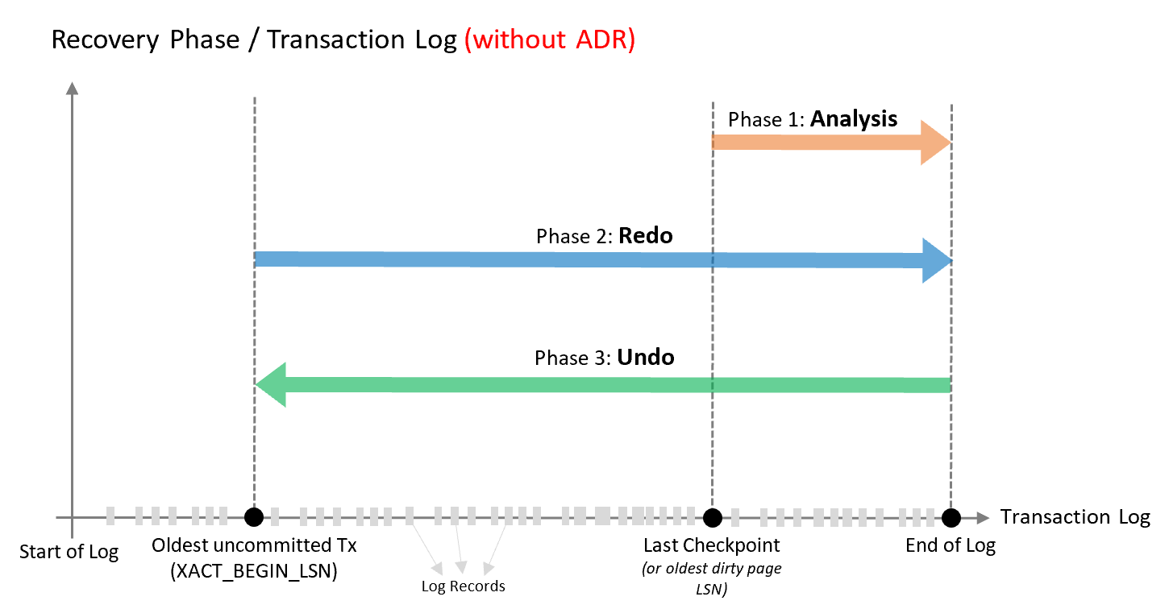
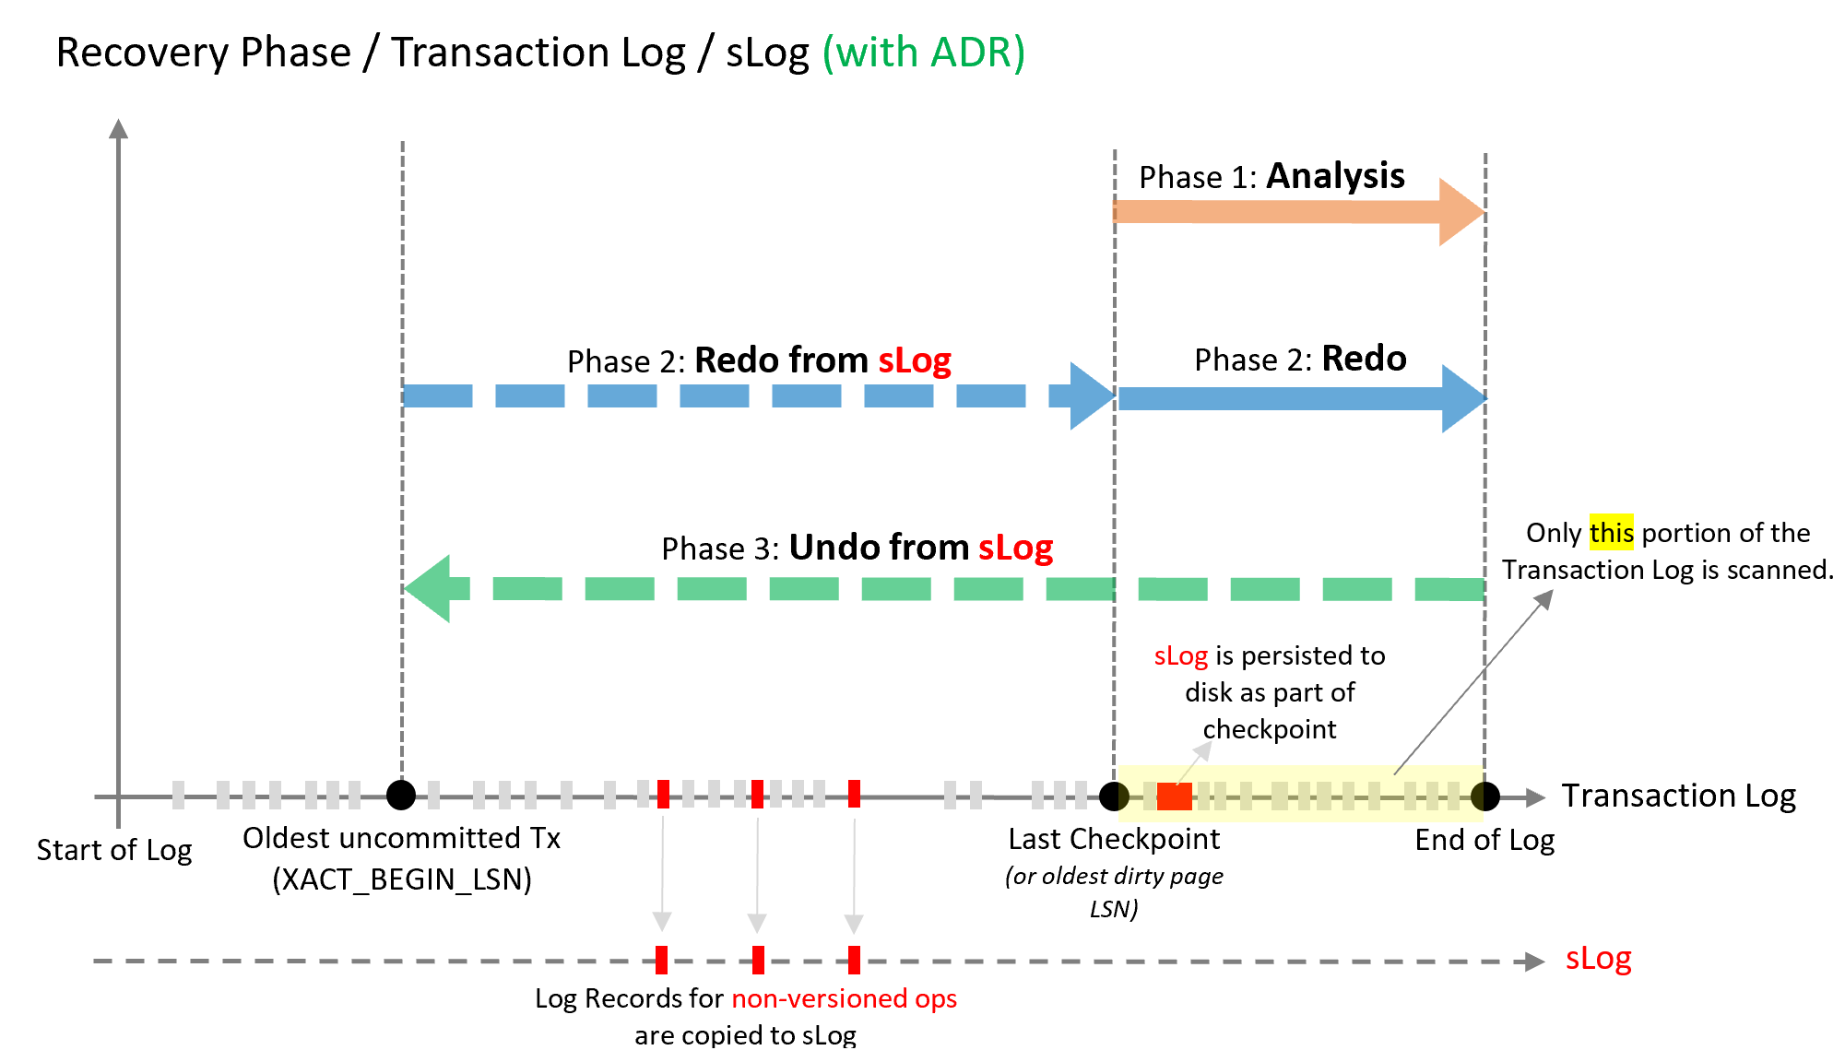
Accelerated database recovery
Overview
New SQL database engine feature
Redesigns the engine recovery process
Speeds up the 3 recovery phases
Benefits
Fast and consistent database recovery
Instantaneous transaction rollback
Regardless of number or age of transactions
Fast pause and resume operations
Notes:
https://docs.microsoft.com/en-us/azure/sql-database/sql-database-accelerated-database-recovery
3 phases of database recovery
Analysis phase
Forward scan of the transaction log from the beginning of the last successful checkpoint (or the oldest page LSN) until the end, to determine the state of each transaction at the time SQL Server stopped
Redo phase
Forward scan of the transaction log from the oldest uncommitted transaction until the end, to bring the database to the state it was at the time of the crash by redoing all operations
Undo phase
For each transaction that was active as of the time of the crash, traverses the log backwards, undoing the operations that this transaction performed.
ADR uses the same 3 steps, but uses four key components to help speed up recovery:
Persisted Version Store (PVS)
The persisted version store is a new SQL database engine mechanism for persisting the row versions generated in the database itself instead of the traditional tempdb version store. PVS enables resource isolation as well as improves availability of readable secondaries.
Logical Revert
Logical revert is the asynchronous process responsible for performing row level version based Undo - providing instant transaction rollback and undo for all versioned operations.
sLog
sLog is a secondary in-memory log stream that stores log records for non-versioned operations (such as metadata cache invalidation, lock acquisitions, and so on).
Cleaner
The cleaner is the asynchronous process that wakes up periodically and cleans page versions that are not needed.

Slide 52
What’s new since Gen2
Notes:
GA was May 1, 2018
https://azure.microsoft.com/en-us/updates/elevate-your-performance-with-azure-sql-data-warehouse-gen2/

Slide 53
Since Gen2 GA
05/14/18 Automatic Statistics
06/16/18 User Defined Restore Points
06/21/19 Column-level security
07/25/18 Fast Restore
08/02/18 Recommendations for data skew and table statistics
09/24/18 Streaming support in Azure Databricks
09/24/18 User defined maintenance scheduling
09/24/18 Vulnerability assessment
09/24/18 Intelligent Insights
09/24/18 Flexible Restore Points
11/07/18 RLS
11/12/18 Azure Monitor log support
12/08/18 Azure Virtual Network service endpoints
01/10/19 Azure Data Box Disk
Upcoming Features:
Copy Command
Work Load Management
Notes:
https://azure.microsoft.com/en-us/updates/?product=sql-data-warehouse
Data Box Disk

Slide 54
Q&A

